Slide 1
Python Case Study
By Prajwal Adhikari

Slide 2
Introduction to Python
Created by Guido van Rossum in 1991
High level, general purpose programming language
Supports multiple programming paradigms such as imperative, functional, procedural and object oriented.
Unlike other high level languages like C, C++ which are compiled language, python can be both compiled and interpreted but is regarded as interpreted in general context.
Platform independent
Designed to be highly extensible
Compact modularity allows adding various programming interface

Slide 3
Continued…
Various implementations such as CPython(C), PyPy, IronPython(.Net), Jython(Java)
Most popular implementation is CPython which is simply referred as Python.
Has two modes: script and interactive.
In scripted mode finished .py files are run on the interpreter and on interactive mode user can directly enter code in command shell to get immediate feedback
Dynamically typed language i.e. when a number or word is made in program the user does not have to assign its type.
x = 1
print(x)
x = "Word"
print(x)
The code will make both number and word and show them both using one variable

Slide 4
Why Companies prefer Python/Advantages of Python
Availability of numerous libraries for different purposes
Active and involving community
Free and Open source
Fewer lines of code for the same function as compared to other programming languages such as C++ and Java
Beginner's language
Portability
Platform Independent
Simplicity and Readability
Extensive libraries

Slide 5
Demerits of Python
Slower than C or C++
Not suitable for mobile development
Has high memory consumption, not good for memory intensive tasks due to flexibility of data types
Database access layer is primitive so it has limitations with database access
Errors only show up at run time so it requires more testing

Slide 6
Scope and Application of Python
Can be used in various purposes like web development, GUI Desktop application development, machine learning, data mining, scientific and numeric computing, etc.
Web Development ->
Python has libraries for internet protocols and easy to use socket protocols. Also web development frameworks are available such as Django and pyramid
Desktop GUI Applications->
Scientific and Numeric Applications->
SciPy - Collection of packages for Mathematics, Science and Engineering
Pandas- Data analysis and modeling library
Numpy - Let us deal with complex numerical calculations

Slide 7
Continued…
Python Applications in Education->
Because of simplicity, brevity and large community python makes for great introductory programming language
Business Application->
Python is great for ERP(Enterprise Resource Planning) and e-commerce
Tryton – A high level general purpose application platform
Odoo – A management software with range of business application
Database Access
Network Programming
Games and 3D Graphics

Slide 8
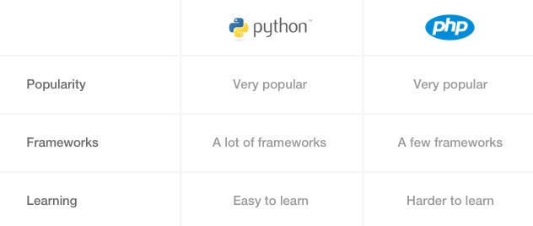
Python vs PHP
In recent years python is gaining popularity over PHP because of ease of use and large scope of application domain.
Python is adopted by famous companies such as Quora, Instagram, Reddit, Spotify. PHP is adopted by companies such as Facebook, Yahoo, Wikipedia, WordPress, etc.
Python is more well designed than PHP
Python is much easier to learn than PHP
Python has better web framework than PHP
Python’s indentation enforcement are very strict which makes code more readable than any other language along with PHP
Syntax is much more simpler in Python than in PHP
Better package management is available in Python than in PHP
Python is more versatile than PHP
Python has vast support and community

Slide 9
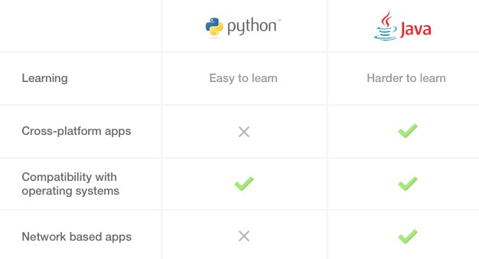
Python vs Java
Python is much more simpler and easier to learn than java
Java has static typing whereas Python has dynamic typing
Cross Platform Apps are better created in Java
Network based apps are better created in Java
40 lines of code in Java can be completed in mere 15 lines in Python

Slide 10
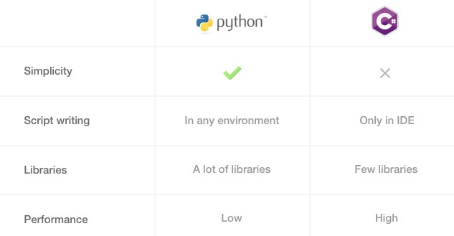
Python vs C#
Python is much simpler than C#
Number of lines of code in Python is much less than in C#
Python scripts can be run in any environment with interpreter whereas C# needs an IDE for normal programming
Python has higher number of libraries as compared to C#
C# has more features and higher performance than Python and it evolves really fast

Slide 11
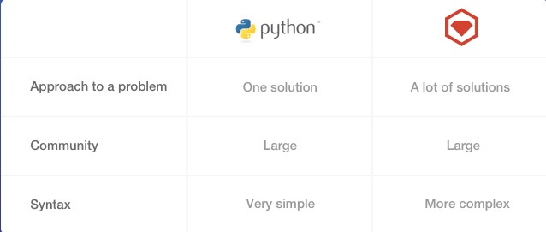
Python vs Ruby
Ruby and Python are very similar to each other.
Ruby is very popular for building websites. It has a web framework called Ruby on Rails(RoR) which is very similar to Django(a python web framework)
Basecamp, Github, Airbnb, Slideshare, etc. are built on Ruby
Python is better for building apps with lots of computing and data processing while Ruby is better suited for building traffic heavy apps
The communities of both the languages is very vast. The only difference is the people who form it. Python majorly deals with data science and mathematics so there are lots of academics and professors in python community.

Slide 12
Rank By Performance
C#
Java
PHP
Python
Ruby

